Slide 1

Great idea!
Unit 5
English in Mind 11H

Slide 2

You and technology…

Slide 3
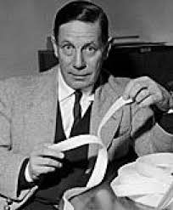

Velcro: George de Mestral

Slide 4
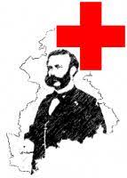
The Red Cross

Slide 5


Swiss Army Knife

Slide 6

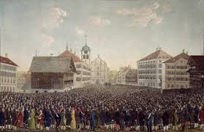
Direct Democracy

Slide 7
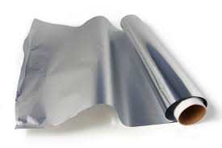
Aluminum Foil

Slide 8
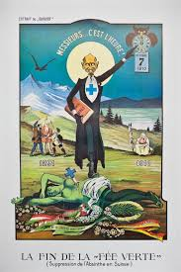
Absinthe

Slide 9

Muesli

Slide 10
Very strange inventions….
https://youtu.be/RgZyJM_nwG4

Slide 11
Listen and watch https://youtu.be/bNUfZ3_VkuE
Fill in the blanks as you listen to a video about important inventions.

Slide 12
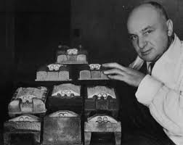
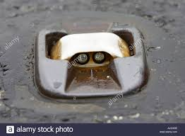
What can you see in the pictures?

Slide 13
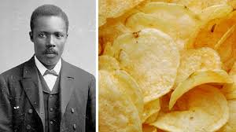

Slide 14
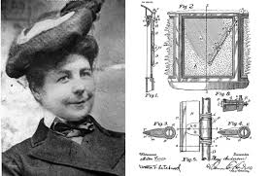

Slide 15
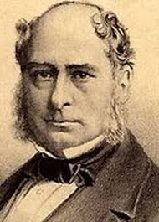
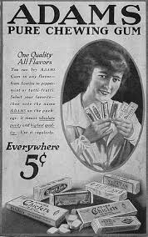

Slide 16
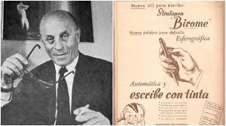

Slide 17
Question words…
What
Who
When
Where
Why
Which
How many
How much

Slide 18
What a thing
Who a person
When a time
Where a place
Why a reason
Which a choice
How many countable things
How much uncountable things

Slide 19
Past simple questions…
Karl Benz invented the first motor car.
        Subject Object
Somebody invented the motor car. Karl Benz invented something.
Who invented the motor car? What did Karl Benz invent?
Karl Benz. The first motor car.

Slide 20
To make past simple questions…
Did + infinitive without to…
The past form of the verb without did
After WHEN, WHERE and WHY
If WHO or WHAT is the object of the verb
When did he invent it?
What else did he invent?
Where did he work?
If WHO or WHAT is the subject of the verb
Who drove the car first?
What gave him the idea?
Who worked with him?

Slide 21
Very interesting inventions…
https://youtu.be/rGijY4mJbGo

Slide 22

Get…
Arrive
Become
Receive

Slide 23



Get
BECOME: angry, rich, wet
ARRIVE: home late, to school late
RECEIVE: a phone call, a surprise, an idea (s)

Slide 24
Past continuous…
https://youtu.be/5vmHyTCaqeg
What was happening…what happened?(2 x 2 discussion)
https://youtu.be/IQBAoVeUvh4
Watch as a class and discuss
https://youtu.be/rvHg58jTqzc
Game show
https://youtu.be/MGLedoA3SSE

