Slide 1

Simple past
Key points to remember

Slide 2

To be = was/were
I was He, she, it was They were
You were We were

Slide 3
Was not = wasn’t were not = weren’t
In the negative form…

Slide 4
Was I, he she, it…? were you, they…?
Questions with the verb ‘to be’ in the simple past…

Slide 5
Go ahead ask each other some questions using = were you…?

Slide 6

Regular verbs in the simple past…have you seen ed anywhere?
He must be somewhere…what do you think?

Slide 7

So how do we know how to put the regular verbs in the past?
Here are some rules to remember…

Slide 8
Normally we just add –ed to the verb…
Watched, looked, waited, brushed, etc.

Slide 9

But when a verb already ends with an ‘e’ we just add a ‘d’ …so easy!
Liked, loved, hated, moved, cared, etc.

Slide 10
And if the verb ends with ‘y’ there are some things to think about…
Play, stay…if there is a VOWEL in front of the ‘y’ we just add –ed.
Carry, cry, try…if there is a CONSONANT in front of the ‘y’ we change the ‘y’ to ‘i’ and add –ed.

Slide 11

If the verb contains a consonant-vowel-consonant and is one syllable…
You double the last letter: stopped, planned with the EXCEPTION of travelled (British English) and traveled (American English)

Slide 12
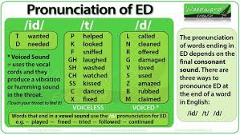

Now pronunciation…

Slide 13
'id’ = ending with ‘t’ or ‘d’ sounds
Wanted
Needed

Slide 14
‘t’ = ending with p, k, f, gh, sh, ch, ss, c, x sounds
Helped, looked, sniffed, laughed, washed, watched, kissed, danced, fixed

Slide 15
‘d’ = ending with l, n, r, g, v, s, z, b, m (and others) sounds
Called, cleaned, offered, damaged, loved, used, amazed, rubbed, claimed,

Slide 16
Write down ten verbs of your choice and pronounce them to your partner….

Slide 17

Now in the negative…
Subject + did not (didn’t) + verb (NO CHANGE!!!!!)
I didn’t see you yesterday.

Slide 18
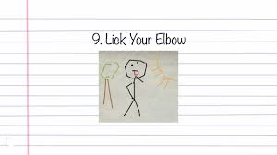
Tell your partner three things that you didn’t do yesterday….

Slide 19
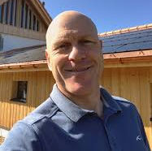
And if you want to ask a question…ask didier…
Did + subject + verb (no change)…
Did you see Didier yesterday?

Slide 20
Now ask your partner three questions about what they did last week…
Or yesterday, last month, last weekend, etc.

Slide 21
Now is it easier to understand now?
Choose 10 regular verbs in the past and send me an email…you can use them in the affirmative, negative or question form.

Slide 22
What about the irregular verbs…
Memorize them please…you can do it!!!

