Slide 1
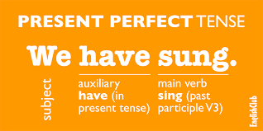
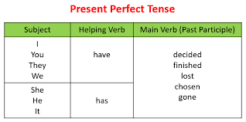
Welcome to the present perfect class

Slide 2
This verb tense is very popular in english….
We will work on this verb tense for a time period of 3 weeks…yes, three weeks because it is important.
You have already learned your irregular verbs…so it is easy-peasy. If not…review….
It is the 3rd column…which is called the past participle.

Slide 3
SO you use the magic formula….
Subject + have/has + past participle
(I, you, we, they) + have + lived in Switzerland since 2012.
(He, she, it) + has + been outside for three hours.

Slide 4
A virtual lesson…
Please watch the video and take notes if possible.
https://youtu.be/q1LKzp2ozVM

Slide 5
Some key points to remember…
Is the action completely finished with NO connection to now?
It is not finished YET… (pas encore).
This tense is called the ‘unfinished past.’

Slide 6
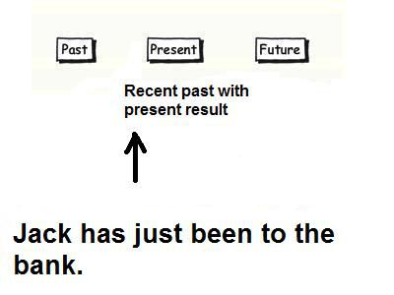
Here are some KEY words to remember…
just
yet
already
recently
Positive example:
Jack has just been to the bank.
Negative example:
Peter hasn't finished his homework yet.
Question example:
Have you spoken to Andy yet?

Slide 7
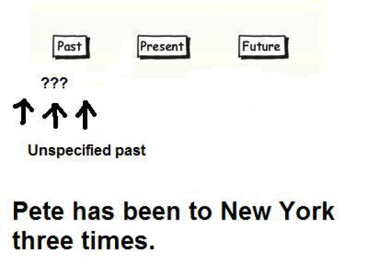
The present perfect is often used in the past at an unspecified moment or cumulative life experiences up to the present.
Some KEY expressions:
twice, three times, four times, etc.
ever
never
Positive example:
Peter has visited Europe three times in his life. (and he may go again…)
Negative example:
I haven't played golf many times. (but I may play more in the future…)
Question example:
Have you ever been to France? (not yet, but maybe in the future…)

Slide 8
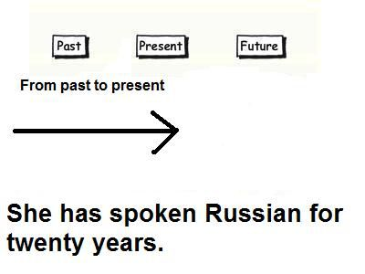
For and since…
1) We use ‘for’ to talk about a PERIOD/ AMOUNT of of time…
Example: for twenty years, for ten days, for a fortnight…
2) We use ‘since’ to talk about a SPECIFIC point in time…
Example: I have lived in Switzerland since 2015…(and I am still here…)

Slide 9
A Slideshare presentation to review…
http://www.slideshare.net/patriciamellino/simple-past-vs-present-perfect-tense

