Slide 1
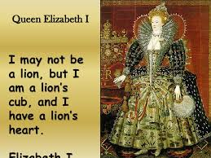
Courtship and marriage in elizabethan times
https://youtu.be/yBS-MktwqgI
https://youtu.be/DH6TqDHV0Bs

Slide 2


Slide 3
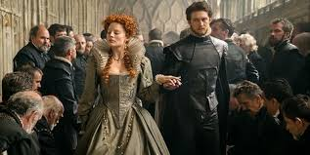
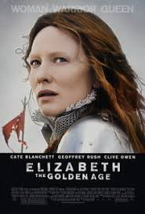
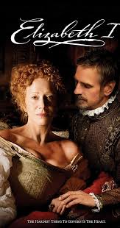
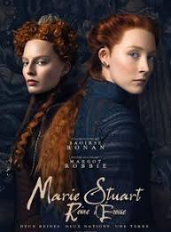
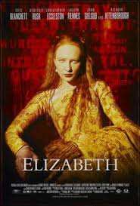

Slide 4

the symbol of the House of Tudor
Elizabeth descends from it
It unifies the lineage of the white rose of York and the red rose of Lancaster.

Slide 5
She loved clothers and was very fashionable. She owned at least 2,000 pairs of gloves.
She started wearing make-up after she had smallpox in 1562 and she had a lot of scars.
She started wearing make-up with white lead and vinegar and this poisoned her over.
Keeping their teeth clean was very difficult and she ended up having rotten teeth and her cheeks started to ‘cave in’ so she ‘stuffed’ clothes into her cheeks to fill out her face.

Slide 6
https://youtu.be/8xN_89uynqw
Elizabeth marries england
She was known as ‘the virgin queen’

Slide 7
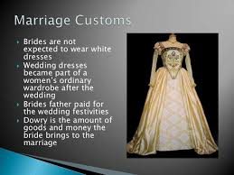
Courtship and marriage in Elizabethan times
Read pages 29-32 in Shakespeare in love
Answer the questions on page 32

Slide 8
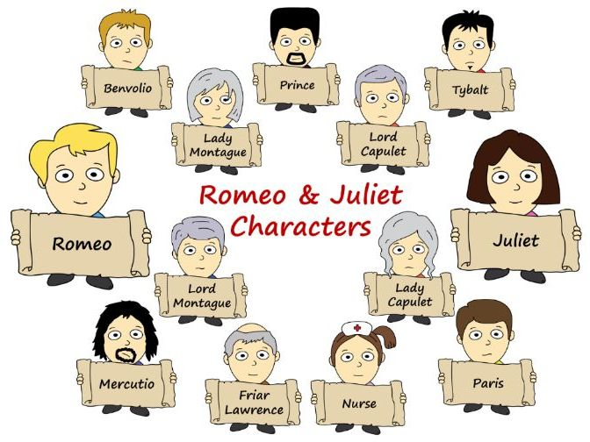
The tragedy of romeo and juliet read about the characters page 34

Slide 9
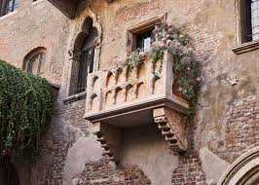
The city of verona in northern italy where the famous balcony is…
https://youtu.be/QG1ETizQhYc

Slide 10
https://youtu.be/jTGWNHa1wIQ
An overview of one of many films made…
Romeo and Juliet trailer

Slide 11

https://learnenglishkids.britishcouncil.org/short-stories/romeo-and-juliet
This is a simplified video of the story of romeo and juliet…

Slide 12
Read part one of romeo and juliet pages 35-38
Do activities on page 34 2 and 3
And pages 40-41
To be corrected next Friday march 27th

Slide 13
Corrections
Page 32 activity 1:
1. Because marriage gave them status and heirs.
2. At 12.
3. Families could obtain property, money and useful friends.
4. Courtship was not a promise to marry. Bethrothal was binding.
5. Because it was the symbol of fidelity.
6. Kiss over them without knocking them down.

Slide 14
Corrections page 34
1. A
2. B
3.B
4. B
5. A
6. A
1. enemy 2. niece 3. cousin 4. guard

Slide 15
Corrections pages 40-41
Activity 1
1.M 2. J 3. H 4. B 5. A 6. C 7. F 8. L 9. N 10. I 11. O 12. K 13. G 14. D 15. E
Activity 2: open answers
Activity 3: 1. of 2. in 3. of 4. about 5. of 6. to

Slide 16
Part 2
Page 42
Send me a ‘virtual postcard’ OR voice message from Verona to Mrsmottier@gmail.com for next Friday following the ideas on page 42.
If you are interested in Verona, you can check out the internet project on page 43

Slide 17
Part two : read pages 45-48
While you read, think about
How Romeo must feel…
What did EXILE mean in the 1500’s…
Why the parents are angry with their daughter…
What did Juliet drink and why…
Why Romeo bought poison…
Why Juliet reacted the way she did…
What good came out of this tragic situation…

Slide 18
Answer the questions on pages 50 and 51 for next Friday
At the end of the course, there will be a TS on the stories we have read (reading comprehension, writing and speaking).
Please read and answer the questions every week.
If you are motivated, do page 52…(not obligatory)

Slide 19
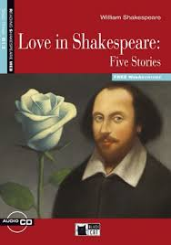
This is excellent practice for next year…

